Slide 1
Unit 1 – Database Design
Instructor: Brent Presley

Slide 3
Tools and Resources
XAMPP (First Part of Quarter)
MySQL Workbench (First Part of Quarter)
Azure (Second Part of Quarter)
Visual Studio Community 2013 (Second Part of Quarter)
SQL (W3Schools)
SQLCourse.com
SQLZoo.net
SQL (TutorialsPoint)
SQL Tutorial
SQL (TutsPlus)
Essential SQL
Learn SQL The Hard Way
Udemy Training (Free): Sachin Quickly Learns SQL
Udemy Training (Free): Database Design
Udemy Training (Free): MySQL Database for Beginners
Udemy Training (Free): SQL Server for Beginners

Slide 4
What is a database?
What is a database?
  https://www.youtube.com/watch?v=t8jgX1f8kc4
Introduction to Databases
  This will preview a lot of information that we will discuss in more detail in the weeks to come
  https://www.youtube.com/watch?v=4Z9KEBexzcM

Slide 5
Hierarchical Database Model
Data is structured hierarchically.
Visualize as an inverted tree.
  A single table acts as the “root” of the tree.
  Other tables act as branches flowing from the root.

Slide 6
Hierarchical Database Model
Agents
Entertainers
Clients
Schedule
Engagements
Payments

Slide 7
Network Database Model
Visualize as an inverted tree.
Several inverted trees may share branches,
All of which are part of the same database structure.

Slide 8
The Network Database Model
Agents
Represent
Manage
Clients
Entertainers
Make
Schedule
Perform
Play
Payments
Engagements
Musical Styles

Slide 9
A Basic Set Structure
Owner Table
Agents
1
Represent
Set Structure
Relationship
Member Table
Clients
M

Slide 10
Enter . . . The Relational Database Model
Relational Database
Relational Databases
Relational Databases

Slide 11
Relational Database Model
Data is stored in relations, which are perceived by the user as tables.
Each relation is composed of tuples (records) and attributes (fields).

Slide 12
Relational Database Model
The physical order of the records of fields in a table is completely immaterial.
Each record in the table is identified by a field that contains a unique value.

Slide 13
A Relational Database Model
Agents
Clients
Entertainers
Musical Styles
Engagements
Entertainer Styles

Slide 14
History of Database Systems
File systems (before mid 1960s)
Problems: Data redundancy
update anomalies
no abstract data model
requires knowledge of storage details
no standard query language

Slide 15
Hierarchical Databases (mid 1960s)
Developed by North American Rockwell and IBM
as the IMS (Information Management System)
Based on a tree structure
Example: A Product assembled from components, which are assembled from subcomponents
Problems: Changes in data structure require changes
in application programs that access that structure
No Many-to-Many relationships
Programmers must be thoroughly familiar with the
database structure.

Slide 16
Network Databases
Extension of the hierarchical data model
Standardized (1971) by the CODASYL group (Conference on Data Systems Languages)
Advantage: Many-to-Many relationships are implemented
Problems: “Navigation” is even harder

Slide 17
Relational Databases
Proposed in 1970 by E.F. Codd while working at IBM.
“IBM largely ignored his work, as the company was investing heavily at the time in commercializing IMS databases….
It was not until 1978 that Frank T. Cary, then chairman and CEO of IBM ordered the company to build a product based on Dr. Codd’s ideas.

Slide 18
Oracle emerges
But IBM was beaten to the market by Lawrence J. Ellison, a Silicon Valley entrepreneur, who used Dr. Codd’s papers as the basis of a product around which he built a start-up company that has since become the Oracle Corporation.”
New York Times April 23, 2003
Obituary of E. F. Codd (1923-2003)

Slide 19
1. Relational Databases
Data Abstraction- allows people to forget
unimportant details
  View Level – a way of presenting data to a
  group of users
  Logical Level – how data is understood to be
  when writing queries

Slide 20
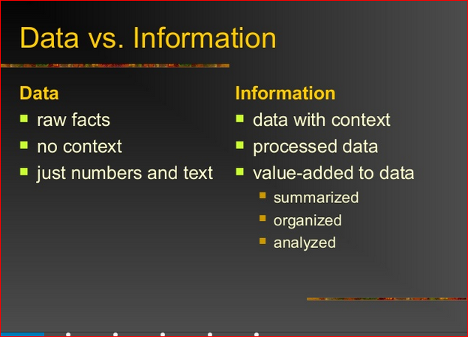

Slide 21
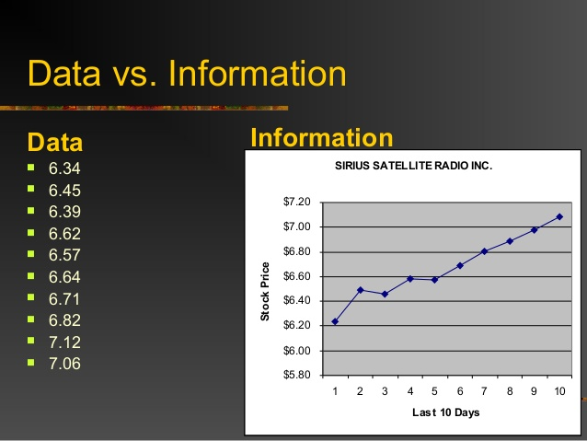

Slide 22
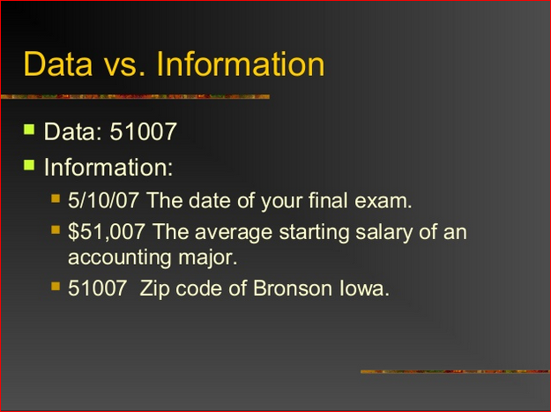

Slide 23
What is a null?
It basically means both since the a column allows NULL and there is no default value set for the column. If you insert into the table and don't specify a value and there is no default value for the column, the value will be null (undefined).

Slide 24
Entity
An entity can be a real-world object, either animate or inanimate, that can be easily identifiable. For example, in a school database, students, teachers, classes, and courses offered can be considered as entities. All these entities have some attributes or properties that give them their identity.
An entity set is a collection of similar types of entities. An entity set may contain entities with attribute sharing similar values. For example, a Students set may contain all the students of a school; likewise a Teachers set may contain all the teachers of a school from all faculties. Entity sets need not be disjoint.

Slide 25
Attributes
Entities are represented by means of their properties, called attributes. All attributes have values. For example, a student entity may have name, class, and age as attributes.
There exists a domain or range of values that can be assigned to attributes. For example, a student's name cannot be a numeric value. It has to be alphabetic. A student's age cannot be negative, etc.

Slide 26
Attribute types
Simple attribute − Simple attributes are atomic values, which cannot be divided further. For example, a student's phone number is an atomic value of 10 digits.
Composite attribute − Composite attributes are made of more than one simple attribute. For example, a student's complete name may have first_name and last_name.
Derived attribute − Derived attributes are the attributes that do not exist in the physical database, but their values are derived from other attributes present in the database. For example, average_salary in a department should not be saved directly in the database, instead it can be derived. For another example, age can be derived from data_of_birth.
Single-value attribute − Single-value attributes contain single value. For example − Social_Security_Number.
Multi-value attribute − Multi-value attributes may contain more than one values. For example, a person can have more than one phone number, email_address, etc.

Slide 27
Keys
Key is an attribute or collection of attributes that uniquely identifies an entity among entity set.
For example, the roll_number of a student makes him/her identifiable among students.
Super Key − A set of attributes (one or more) that collectively identifies an entity in an entity set.
Candidate Key − A minimal super key is called a candidate key. An entity set may have more than one candidate key.
Primary Key − A primary key is one of the candidate keys chosen by the database designer to uniquely identify the entity set.

Slide 28
relationships
The association among entities is called a relationship. For example, an employee works_at a department, a student enrolls in a course.

Slide 29
Relationship set
A set of relationships of similar type is called a relationship set. Like entities, a relationship too can have attributes. These attributes are called descriptive attributes.
Degree of Relationship
The number of participating entities in a relationship defines the degree of the relationship.
Binary = degree 2
Ternary = degree 3
n-ary = degree

Slide 30
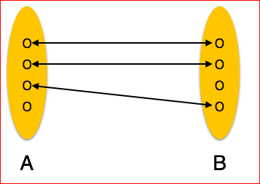
Cardinality
One-to-one − One entity from entity set A can be associated with at most one entity of entity set B and vice versa.

Slide 31
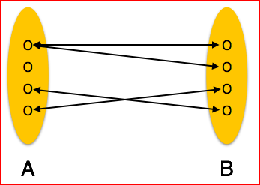
Cardinality
One-to-many − One entity from entity set A can be associated with more than one entities of entity set B however an entity from entity set B, can be associated with at most one entity

Slide 32
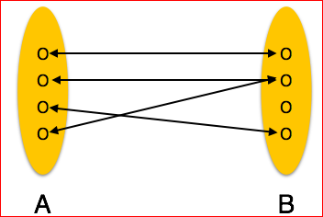
Cardinality
Many-to-one − More than one entities from entity set A can be associated with at most one entity of entity set B, however an entity from entity set B can be associated with more than one entity from entity set A.

Slide 33
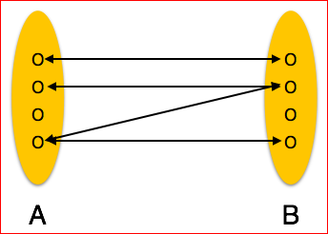
Cardinality
Many-to-many − One entity from A can be associated with more than one entity from B and vice versa.

Slide 34
Database design goals
  Adaptable
    Fields and tables can be added (removed) easily
  Flexible
    Data can be retrieved in an unlimited number of ways
  Accurate
    No data redundancy
    Validation on fields
    Default values
    Look ups

Slide 35
Small group project
You are a known database developer and the parent of a thirteen-year-old son who is actively involved in the local Junior League Baseball program. Your son will be playing in one of the 12 local teams who will be competing in the National Division Junior League Tournament. Each pair of local teams plays twice against each other during the four-month season. With the intention of creating the best conceivable national team, the U.S. Junior Baseball League president, Mr. Henry Zemog, wants to gather appropriate statistics from all team players during the National Division Junior League Tournament.
You have been asked by Mr. Zemog to design a database for tracking each team’s and player’s statistics during the tournament series. The national team will represent the United States in the International Junior League World Series Tournament to be held in Heritage Park in Taylor, Michigan. You will have access to the complete game statistics for each game that is played. You have agreed to fulfill this task.
Using the lessons learned in Chapter 1 about the relational model and your knowledge of basic baseball statistics, use your favorite drawing tool to produce a relational diagram that can serve as a preliminary step toward the final database design. At this stage of the development process, the basic constructs should include only the entities and their relationships. Name the diagram “Junior League Baseball Database.”

Slide 36
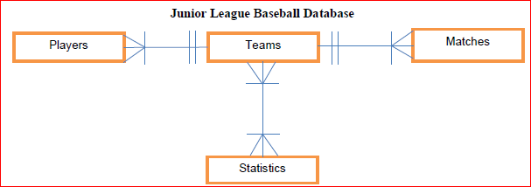
Potential answer to group project
There are many possible solutions…

Slide 37
Group project 2
You are in the requirements analysis phase of designing a database for an organization.
List the pieces of information that you need to acquire from stakeholders in order to
minimize shortcomings and iterations during the preliminary design phase.

Slide 38
Potential items for group project 2
A list of products and services the organization provides
• An organizational chart, a list of stakeholders, and a list of job responsibilities
• Current handling of the information system and record keeping
• Current storage of the data and information, such as forms and reports
• Department that will take ownership of the system
• Personnel responsible for using, entering, and maintaining the data
• Security levels
• Location of the database
• Infrastructure, software, and hardware equipment

Slide 39
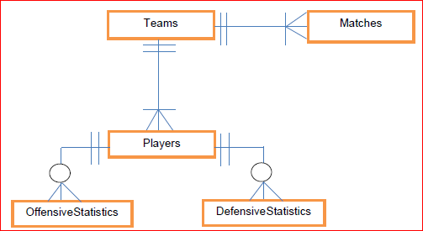
Enhanced baseball table
Add offensive and defensive statistics to the earlier example

Slide 40
Data normalization
Database Normalization is a technique of organizing the data in the database. Normalization is a systematic approach of decomposing tables to eliminate data redundancy and undesirable characteristics like Insertion, Update and Deletion Anamolies. It is a multi-step process that puts data into tabular form by removing duplicated data from the relation tables.
Normalization is used for mainly two purpose,
Eliminating reduntant(useless) data.
Ensuring data dependencies make sense i.e data is logically stored.

Slide 41
Assignment in groups of 2-3
Use the Internet to research normal forms and explain any drawbacks to normalizing data. In your own words, write a one-page summary of your findings and any additional recommendations or observations that you may have.
Include title and reference page (not to be counted toward total pages).

Slide 42
Steps in building a database

Slide 43
Step 1- fact finding
Determine field (data storage) requirements
Sources:
  Current users (owners)
  Existing databases
  Existing forms or other documents
Don’t worry about grouping, simply list
Split multi-part fields into separate fields
  Example: Split Name into FirstName and LastName
  Example: Split Address into Street, City, State and Zip
  Example: Split Phone into AreaCode and Phone, maybe Extension
Handout Student Database field list
Assign Terminology Worksheet

Slide 44
Student enrollment db fields
Social Security Number
Student Name
Email
Program Code
Program Name
GPA
Instructor Number
Instructor Name
Instructor Home Phone
Instructor Business Phone
Email Address
Web Site
Phone number
Phone type
Course Grade
Course Number
Course Name
Description
Credits
Course Time
Course Days
Instructor Number
Street Address
City
State
Zip Code

Slide 45
Step 2 – Name Tables
Table Naming Conventions
  Add the tbl prefix to each table name
  Name tables using either plural nouns or singular nouns. Don’t mix with in a database.
    E.g. tblCustomers, tblLocations, tblVehicles
    E.g. tblCustomer, tblLocation, tblVehicle
    Unique and descriptive
    2012: Lean towards plural nouns
  Ensure abbreviations are clear to everyone, not just those involved in the project.
  Brief, but complete
    Use minimum words necessary
  Don’t include database terminology: Record, File, Table
  Don’t include adjectives that restrict data
    Example: Wisconsin Rapids Employees, Stevens Point Employees
Results in duplicate structures. Structures (field lists) of both tables will be identical
Browse through field list, list those tables that are obvious (others might (will) surface later)
List tables for Enrollment Database

Slide 46
Step 2- name tables
  Make a separate table for multi-value fields.
    Example: a field named Hobbies might contain “bowling, fishing”
    Create a separate Hobbies entity (each hobby will be listed as a separate record in this table)
    Multi-value fields are difficult to search and nearly impossible to validate or sort.
Tip: if the field name is plural, it’s probably a multi-value field.

Slide 47
Step 3- Draw Entity Relationship Diagram
Entity Relationship Diagram (ERD) is picture that shows the relationships between tables of a database
Helps discover additional tables and defines relationships
Rectangle used to represent each table in a database
Line drawn between tables that are directly related
At end of each line, include cardinality
  One occurrence in table 1 is related to how many occurrences of table 2 (maximum number)
  One occurrence in table 2 is related to how many occurrences of table 1 (maximum number)
  For our purposes, the maximum is listed as 1 or many (M)

Slide 48

Entity Relationship Diagram
  The above ERD fragment expresses that:
    “One lab contains (M)any computers”
    “One computer exists in only one (1) lab”
    Entity Relationship Diagram (ERD)
https://www.youtube.com/watch?v=-fQ-bRllhXc

Slide 49
For more information
Data modelling and the ER model
  https://www.youtube.com/watch?v=IfaqkiHpIjo (60)

Slide 50
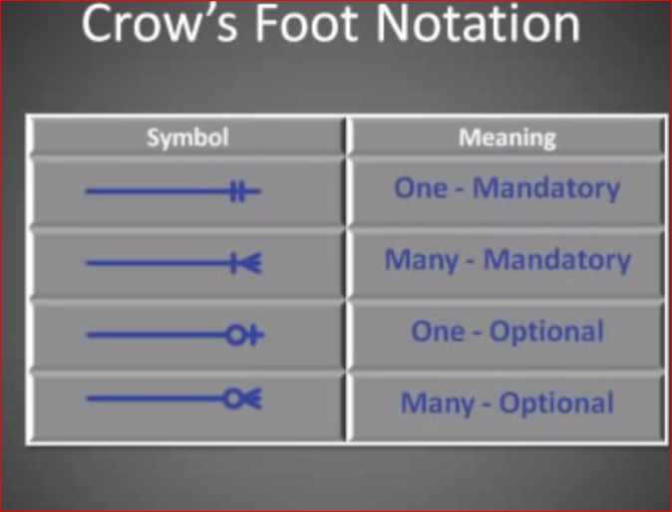
ERD concepts
Crows feet notation- designates the cardinality of the relationship

Slide 51
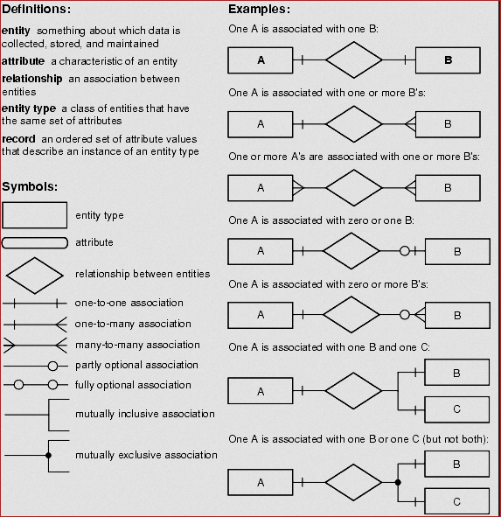
ERD concepts

Slide 52
Draw the ERD for this (group)
As a part of its project management database, the company wants to store information about resources (employees), projects and bookings.
For each employee, the following information is stored: Employee ID, First and Last name, Rank, and billing rate. Employees are organized into solution sets, each solution set has a head of the solution set, who is the resource owner for all employees in that SS. For each solution set we record the SS ID and the SS name. For scheduling purposes, we want to store information about the head of each solution set, and about assignment of employees to solution sets. An employee can belong to only one solution set.
The scheduling system also stores information about project. For each project, the following information is stored: Project ID, Status, Location and Client name.
As a part of the scheduling system, we store information about each calendar day in a year. When a booking is requested for an employee, the employee is scheduled to work on a particular project, on a particular day for the specified amount of time (10%-100%). For each booking we also record current status

Slide 53
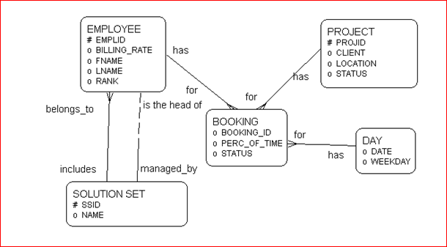
solution

Slide 54
Draw the ERD for this (group)
On-line payment system stores information about all customers, including name, id, address, e-mail and password. Each customer has set up a specific method of payment, which may be a credit card payment or automated direct withdrawal. For all types of payment we store the following information: an ID and the date the method of payment was set up. For credit card payments we store CC number and type and the expiration date. For automated withdrawal we store the name of financial institution, the routing number, account number and the date of monthly withdrawal.

Slide 55
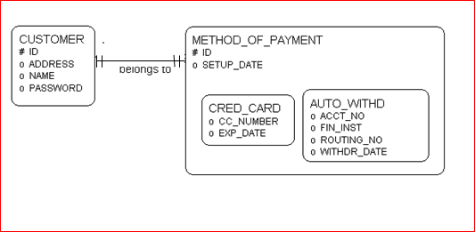
solution

Slide 56
Tools and Resources
XAMPP
MySQL Workbench
SQL (W3Schools)
SQLCourse.com
SQLZoo.net
SQL (TutorialsPoint)
SQL Tutorial
SQL (TutsPlus)
Essential SQL
Learn SQL The Hard Way
Udemy Training (Free): Sachin Quickly Learns SQL
Udemy Training (Free): Database Design
Udemy Training (Free): MySQL Database for Beginners
Udemy Training (Free): SQL Server for Beginners

Slide 57

Step 4 – Determine Primary Key
– Determine Primary Key for each Entity
  The primary key is the field or fields whose value uniquely identifies a record in that table.
    For Lab, it might be Room Number
    For Computer, it might be ID Number

Slide 58
Step 4 – Determine Primary Key
Primary keys can be a combination of two keys
    For Lab, if the building has multiple floors, a combination key might be Room Number plus Floor (e.g. Room 10 on Floor 5)

Slide 59
Step 4 – Determine Primary Key
  If you need to combine 3 or more fields to create a unique primary key, consider creating an ID Number field for that table (surrogate key).
    These keys are usually autonumber fields
    Often times these are used in all tables.
  Primary key requirements:
    Unique. No two keys will have the same value
    Cannot be null. In multi-field keys, none can be null
Values in field rarely (if ever) change

Slide 60
Primary key considerations
Primary keys should be as small as necessary. Prefer a numeric type because numeric types are stored in a much more compact format than character formats. This is because most primary keys will be foreign keys in another table as well as used in multiple indexes. The smaller your key, the smaller the index, the less pages in the cache you will use.
Primary keys should never change. Updating a primary key should always be out of the question. This is because it is most likely to be used in multiple indexes and used as a foreign key. Updating a single primary key could cause of ripple effect of changes.
Do NOT use "your problem primary key" as your logic model primary key. For example passport number, social security number, or employee contract number as these "primary key" can change for real world situations.
http://stackoverflow.com/questions/337503/whats-the-best-practice-for-primary-keys-in-tables

Slide 61
Surrogate vs natural key
On surrogate vs natural key, I refer to the rules above. If the natural key is small and will never change it can be used as a primary key. If the natural key is large or likely to change I use surrogate keys. If there is no primary key I still make a surrogate key because experience shows you will always add tables to your schema and wish you'd put a primary key in place

Slide 62
example
Define keys for enrollment database

Slide 63

Step 5 – resolve many to many relationships
  Many-to-Many (M-M) are relationships where the cardinality is M (many) in both directions.
    The Lab-Computer example above is a 1-M (one-to-many) relationship. The following represents a M-M relationship
    “One customer orders many products.”
    “One product is purchased by many customers.”

Slide 64
Many to many relationships
  M-M relationships are nearly impossible to implement using a database program
  M-M relationships must be resolved into multiple 1-M relationships in order to implement the database

Slide 65
Resolving M-M relationships
Insert a new entity between the two entities
Name the new entity.
  ”What is one occurrence of table1 combined with one occurrence or table2 called?”
  ”One customer ordering one product is called…?
  an ordered product.”
Re-evaluate the cardinality of the new relationships
Probably 1----M [] M----1
(Manys attached to new entity)

Slide 66

M-m relationships
Determine the primary keys (always at least 2) for the new entity.
Usually the keys from the two parents
Parent entities are those on the 1 side of a relationship (Customer and Product)
Child entities are those on the M side of a relationship (Ordered Product)
One entity can be the parent in one relationship and a child in a different relationship.

Slide 67
Other relationship issues
What happens to child records when parent records are deleted?
  Restrict Delete
    Parent record cannot be deleted until all child records (in all child tables) have been deleted.
    Preferred technique. Requires consideration of affects of deleting this parent record
  Cascade delete
    When a parent record is deleted, all associated child records (in all child tables) are automatically deleted
    dangerous

Slide 68
Step 6 – determine foreign keys
For every relationship, the primary key from the parent table must exist in the child table. This is what links the tables together in a relational database.
Often, the links will already exist because of M-M resolution.
If the parent’s primary key does not exist in the child, copy the field into the child table.
  This field DOES NOT become part of the child’s primary key.
  Designate the field as a link (L) – for data dictionary
Copy keys from Student, Section, and Instructor into child tables.

Slide 69
Step 7 – remove calculated fields and constants
Because today’s computers are so fast, it’s better to calculate these values as you need them instead of storing them in the database.
Additionally, if you calculate them as you need them, you ensure the values are always up to date.
Make a separate list of the calculated fields you removed. Include the equation used to calculate the value.

Slide 70
Step 7 – remove calculated fields and constants
  Ensure all the parts of the equations are stored somewhere in the database.
    Equation parts can be stored in different tables (linking allows you to bring them together)
  If parts can be calculated, don’t store them either

Slide 71
Step 7 – remove calculated fields and constants
  Constants are fields that ALWAYS store the same value
    No need to waste storage space
    Print the constant value on reports when needed
There are exceptions to this rule. Values that rarely change, though calculated, may be fields in the database. I’ve never run into an instance of this though

Slide 72
Update database
Remove GPA from Student table
GPA = Total Points /
Total Credits
Total Points = Sum of all grade points
Total Credits = Sum of all credits earned
✓ Grade Points available (determined from letter grade)
Credits Earned available
Remove State (constant)
Remove City, create ZipCity table to lookup city based on zip
Zip is linking field in Student
Assign fields to entities in Enrollment database

Slide 73
Step 8- Assign remaining fields to entities
  For all remaining fields (from Step 1), assign to one and only one table.
Only linking fields may be duplicated in a database

Slide 74
Field naming standards
Field Naming Standards
  Apply to primary keys and linking fields as well.
  Use singular nouns
    If plural makes more sense, this is not a field but another table.
  Unique and descriptive
    Include table name when field name occurs in two tables (StudentAddress, InstructorAddress)
    (optional)
  Use minimum number of words
  Use acronyms and abbreviations wisely (only if everyone understands them)
  If the name includes “/” “&” “-“ “and” “or”, it probably represents two or more fields. Split them.
  Split multipart fields into separate fields
    If a field can be decomposed into parts, it’s probably more than one field.
Example: Address (street, city, state, zip)
Phone (area code, number, extension)

Slide 75
Step 9 – for all fields, determine type and size
  Use types and sizes available in your database program
  Types and sizes of linking fields (foreign keys) must be identical in each table
  MYSQL : int or varchar
    Varchar(20)
    Int (if it’s automatically assigned)

Slide 76
Mysql common data types
VARCHAR (string 0-255 characters)
TEXT (0-65k characters)
INT
BIGINT
DATE
DATETIME
BOOLEAN
http://www.cheatography.com/davechild/cheat-sheets/mysql/

Slide 77
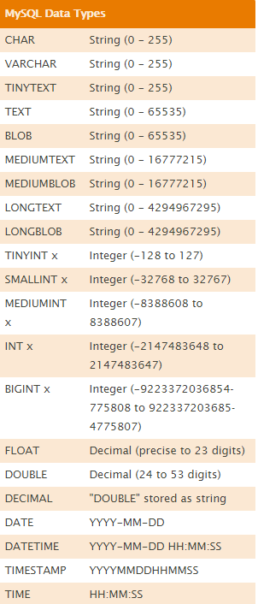
Mysql data types
Complete listing

Slide 78
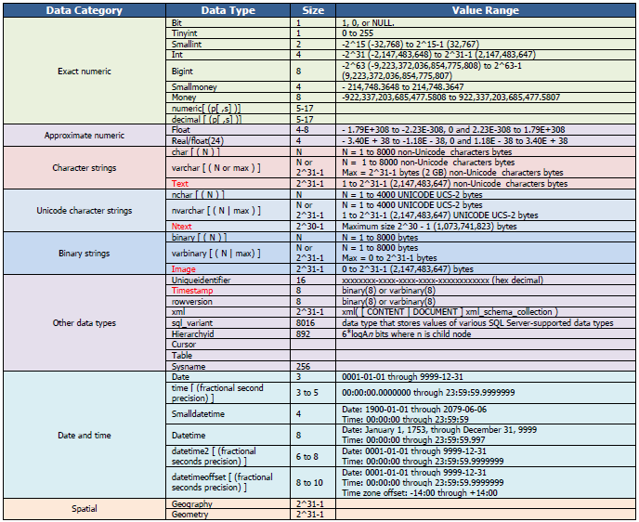
Sql server data types

Slide 79
Step 9 – for all fields, determine type and size
    Long Text (Memo)
      Text–type field that can store up to 4.2 e9 characters
    Number
      Access has five different types of Numbers
      Select the appropriate type to use memory/storage effectively
        Byte (whole number, 0-255)
        Integer (whole number, ±32,767)
        Long Integer (whole number,
        ±2.1 billion)
        Single (number with decimals, 7 digits of accuracy after decimal point)
        Double (number with decimals, 15 digits of accuracy after decimal point)
        RARELY USED!
Example: B I L S or D

Slide 80
Step 9 – for all fields, determine type and size
    Date/Time
      Stores a combination of date and time or any part thereof
        Example: D/T
    Currency
      Stores a dollar amount
      Usually better to use Single from above
      Example: $

Slide 81
Step 9 – for all fields, determine type and size
Yes/No
  Stores a boolean value: yes/no, true/false
  Example: Y/N
Hyperlink
  Stores a web address or email address
  Example: H
OLE Object
Stores, or links to, an image, sound clip or video clip

Slide 82
Logical keys
A logical key represents any column in a table for which you have defined an attribute and in case if there are multiple attributes from the same hierarchy, the key is shown only for the lowest level attribute.

Slide 83
Designate logical keys
In tables that use autonumber fields, you should (with the user/owner’s help) determine which fields in the table should not allow duplicate values.
The autonumber field will ensure the primary key will not have duplicate values
If the primary key is NOT an autonumber field, it should always be designated as a logical key. Your program must ensure the field is not a duplicate to prevent the database from causing an error.
But, there are usually other fields in the table that should not contain duplicates.

Slide 84
Designate logical keys
In a movie database, you might include a autonumber primary key, but the database should not allow duplicate entries for movie title combined with release date
Some tables may allow duplicate records but only with user permission.
  In a student table (with autonumber primary key), your GUI program might allow two (or more) students with the same first, middle, last name combination—but only with user permission.
These types of tables are fairly rare. Most tables have logical keys that are never duplicated.

Slide 85
Logical keys guidelines
Every table has logical keys
Autonumber fields are NEVER logical keys
Primary keys that not autonumber are ALWAYS logical keys
Linking table linking fields are always logical keys
Think about all other fields, should duplicates be allowed? If no—logical key
Look for combinations of fields. Should their concatenated values allow duplicates? If no-logical keys.

Slide 86
Step 10 – ensure no redundancy except linking fields
  Check for synonyms, two fields with different names that are actually the same thing.
    Example: Social Security Number and Employee ID
Double-check to ensure non-linking fields only occur in one entity

Slide 87
Step 10 – ensure no redundancy except linking fields
Field Formatting / Validation Considerations
  Designate digits required for text field
  Use a lookup for this field
  All linking fields should be lookups
  Autocap: automatically capitalize the first letter of each word in the field
  Uppercase: automatically capitalize all letters in the field
  N1-n2: numeric value range check

Slide 88
Step 10 – ensure no redundancy except linking fields
Field Formatting / Validation Considerations
  Auto populate from field
    Automatically populate this field from another field in the database (credits earned = current credits)
    Not a lookup
    User not usually allowed to edit
  Required
    Keys are automatically required

Slide 89
Additional thoughts
  Database design is best done by a group of people unless you have significant experience.
  Don’t be afraid of undiscovered errors in your design
    When you build the database, errors will surface and you can correct them early
    When you populate the tables with data, other errors might surface. Again, you’ll usually catch these early on.
If you follow these guidelines, your database will be adaptable, flexible and accurate. Any design errors you find after using the database for a while (lots of data entered) should still be relatively easy to correct, especially with Access’ help

Slide 90
data dictionary
•A data dictionary, or data repository, is a central storehouse of information about the system’s data
•An analyst uses the data dictionary to collect, document, and organize specific facts about the system
•Also defines and describes all data elements and meaningful combinations of data elements

Slide 91
data dictionary
A data element, also called a data item or field, is the smallest piece of data that has meaning
Data elements are combined into records, also called data structures
A record is a meaningful combination of related data elements that is included in a data flow or retained in a data store

Slide 92
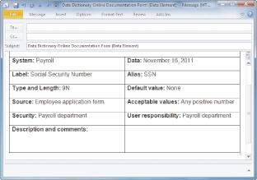
data dictionary
Documenting the Data Elements
◦You must document every data element in the data dictionary
◦The objective is the same: to provide clear, comprehensive information about the data and processes that make up the system

Slide 93
data dictionary
Documenting the Data Elements
◦The following attributes usually are recorded and described
  Data element name and label
  Alias
  Type and length
  Default value
  Acceptable values - Domain and validity rules

Slide 94
data dictionary
Documenting the Data Elements
◦The following attributes usually are recorded and described
  Source
  Security
  Responsible user(s)
  Description and comments

Slide 95
Data dictionaries
Data dictionary must contain the following information:
Table Name
Field (attribute) name
Expanded field name
Field contents or long description
Data type and length or size
Default value(s)
Format (required or optional digits or characters & sequence of characters if appropriate)
Domain (range or choices)
Allow NULL? (Y or N)
Key (PK or FK)
Foreign Key referenced table

Slide 96
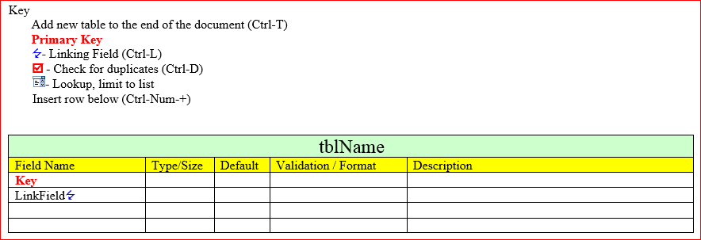
data dictionary document

Slide 97
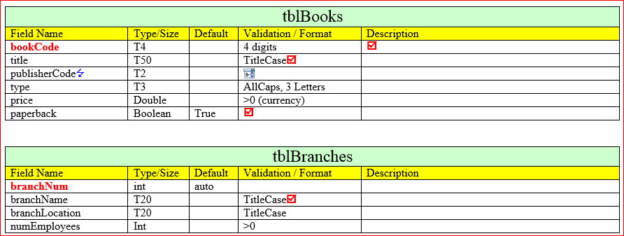
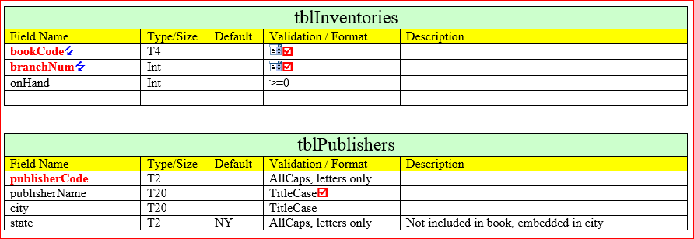
data dictionary document

Slide 98
Design Objectives
A logical design of the database is highly important. Wizards that help you create tables are of no real use if the database itself is designed improperly. Accuracy, integrity and consistency of data will be dependent upon a good design. Many problems can arise if there are design flaws, such as inaccurate retrieval of information.
Objectives of Good Design:
Supports required and ad hoc information retrieval
Contains efficiently constructed tables
Imposes data integrity at the field, table and relationship level
Data must provide accurate and valid information that is meaningful to the organization
The database structure should be easily modified for possible future growth
Advantages of Good Design:
Easy to modify and maintain the structure
Easy to modify data
Easy retrieval of information
Easy to develop and build user applications

Slide 99
Design Objectives
There are three traditional design methods:
A requirements analysis phase involves examining the business being modeled, interviewing users and management to assess the current system and to analyze future needs and determining information requirements for the business as a whole
A data modeling phase involves modeling the database structure itself by using a method such as entity relationship diagramming (ER diagramming). This provides a means of visually representing various aspects of the database structure, such as the tables, table relationships and relationship characteristics.
The normalization phase is the process of decomposing large tables into smaller tables in order to eliminate redundant data, duplicate data and avoid problems with inserting, modifying or deleting data. Table structures are tested against normal forms, which are a specific set of rules that can be used to test a table structure to be sure it is sound and free of problems. These normal forms are: First through Fifth Normal Forms, Boyce-Codd Normal Form and Domain/Key Normal Form.
We will be discussing NORMALIZATION a bit later

Slide 100

Introduction to Database Modeling
Time to see how to design or model a relational database, and this is regardless of which relational database management system you're going to use to do it. We're developing the formal description of our database, what's called the database schema, our tables, our columns, our primary keys in relationships.
If you want a foolproof method of building a terrible database, it's to jump directly into the Database Management System software, whatever that is, and just start building something. That's a really bad idea.
Planning is vital, because while in other areas of development, mobile programming, desktop, web development, I'm a big fan of agile, incremental, iterative approach. Building something quickly, getting it out, revising it, adding new features over weeks or even days, that's not what I want to do with databases. Relational databases reward upfront planning, because the entire point is to impose rules and constraints and structure on your data. We don't want to have one set of rules one week and a different set of rules next week. I once heard the comment that building a database is like getting tattooed. You really want it to be correct the first time you do it. Changes are possible, but they are painful. Unlike tattooing, some changes may be easier than others.

Slide 101
Introduction to Database Modeling
The great thing is relational databases aren't new. They've been around since the '70s. So you're coming in at a time when the methods for modeling a database have been battle tested over four decades. We know what works and what doesn't. And to design a good database, a large part of it is just to go through the steps.
Now, database modeling is not a place to try and express your inner creativity and find wild and crazy innovative new ways of doing things. If you want to get wild and crazy and innovative, fine, but do it in your user interface, do it in your application, not in your database.
In your database schema, you want to be patient, methodical, and step by step.
As with other areas of software development, there are specific diagrams associated with planning a database schema. Unlike other areas, you can get super formal with these, but you rarely need to. A few basic lines and shapes are all we'll need.
While you can use a diagramming tool like Visio (Windows) or OmniGraffle (Mac) and many of the Database Management System tools—and programming IDEs come with basic database diagram tools as well—you really need to model a database, at least initially, is pencil and paper and be prepared to think for a moment about a few core questions.

Slide 102

There are two initial questions you need to ask before even starting your database schema.
First, what's the point? What is this database for?
And be careful of the first answer that leaps to mind.
Sure, in most cases, you're building a database to support an application, whether that's a desktop or mobile or web app.
Let's say you're building an online bookstore, well, it's way too easy to say the point of the database is to store product and order information, and think you're done.

Slide 103
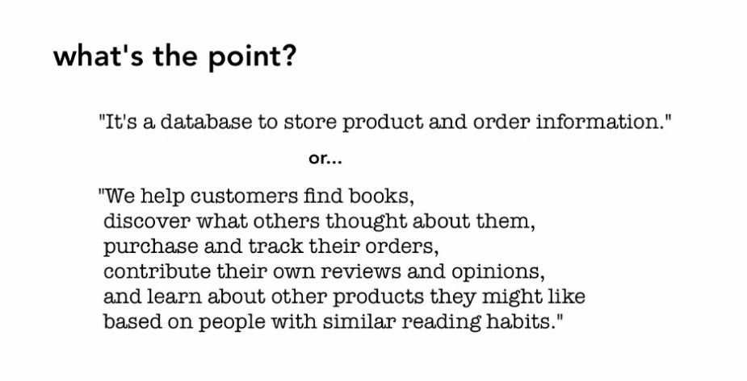
You description might be true, but what's the intention of this bookstore, whether it's a website or an application? Because wherever you wanted to go over the next year or two or five should affect what you're building right now. So even having an elevated or wordy mission statement as corny as that might sound, will help you build a better database.
You're going to build a very different database from that second description than you would from the first one.

Slide 104

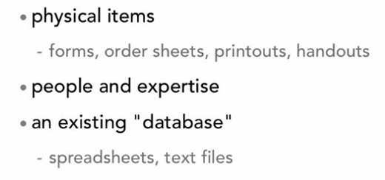
Now the next question, what do you already have?
You might be lucky enough to be building this for a completely new business where nothing has happened yet.
Most of the time, there is some existing process, this database is intended to replace or supplement, even if it's a manual one.
Notes:
Get any physical assets together, print-outs, order sheets, filing cabinets, and of course, people. It's going to help you figure out what data you need to keep track of. Next, do you have an existing database even if one isn't really worthy of the name? It could be in a desktop application, it could be in a set of spreadsheets. If so, what's wrong with it? What's right with it? Don't just make the assumption that you'll take everything you have as gospel and import it all into the new database. You might need to do that, but take the opportunity to fix any problems that you have, so you're not just recreating the same problems in your brand new database schema. So, understanding what you already have is essential before you can answer the first real question when designing a database. Which is, what entities do you have?

Slide 105
Entities and Attributes
Understanding what you already have is essential before you can answer the first real question when designing a database.
What entities do you have?
We know that the relational database consists of one or more tables. Tables are the basic building block of a relational database, and you will create separate tables for each entity, that is each object or each thing that needs to be represented in the database.
We're trying to identify what entities we naturally have, rather than just directly asking, what tables do I need to go and make? Some of your entities might represent things that exist in the real world, Customer, Product, Employee, a Patient, an Asset, but others could be more abstract, a Blog entry, a Category, a Comment, an Appointment.
NOTE: there is some debate about whether to use plural or singular nouns when naming your entities or tables. Is it a Customer entity or a Customer's entity? I'm strongly in preference for singular nouns for tables.

Slide 106
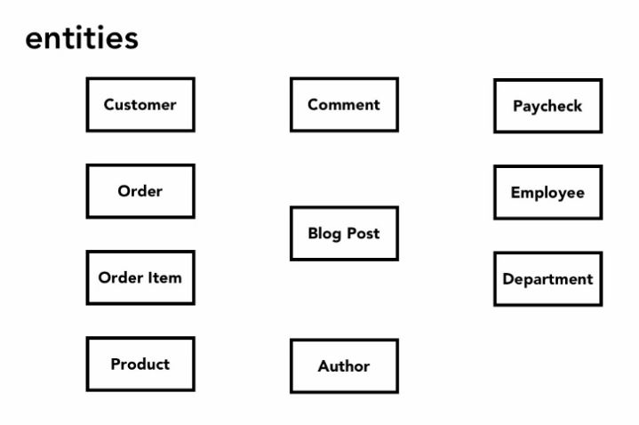
Notes:
We know that the relational database consists of one or more tables. Tables are the basic building block of a relational database, and you will create separate tables for each entity, that is each object or each thing that needs to be represented in the database. I'm using the word entity here just to keep things a little loose and abstract. We're trying to identify what entities we naturally have, rather than just directly asking, what tables do I need to go and make? Some of your entities might represent things that exist in the real world, Customer, Product, Employee, a Patient, an Asset, but others could be more abstract, a Blog entry, a Category, a Comment, an Appointment.
A sidebar, there is some debate about whether to use plural or singular nouns when naming your entities or tables. Is it a Customer entity or a Customer's entity? Now I'm strongly in preference for singular nouns for your tables. That also seems more natural when you describe your entities that way, but I have certainly encountered databases where every table was named plurally, a Customer's table an Order's table. It's not a big deal, but I'd strongly suggest to pick one or the other, don't mix them. If you're on the fence about it, pick singular. So, sidebar over and back to it.
Right now, we want nothing more than just to pick the most useful words. We're not yet worried about exactly what data to store for each one. That will come later, but one word of warning. Take care if you've already done or are doing a similar kind of process for your application itself, and you're working in an object oriented language, because you often ask similar kinds of questions. What exists in this application? You might even be writing use cases, and going through and picking out all the nouns. Sure, there is some crossover in, for example, a sales application I am likely to have both an order table defined in my database and an order class defined in my application, but it is different. In the relational database, we are concerned about the data that needs to be saved. Our focus is not on things like methods and behavior, or inheritance, polymorphism, like it might be in an object oriented language. So we're concerned here just about our entities, and we will be concerned about relationships between those entities.

Slide 107
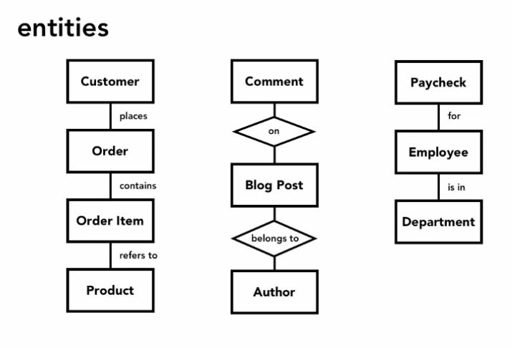
Notes:
Relationships like the fact that our customer places an order then an order contains order items that refer to specific products whether the Paycheck is for a specific employee who belongs to a particular department. In fact, the stage of the process determining your early design is often referred to as Entity Relationship or ER modeling. It's a complex sounding term that at heart really isn't that bad, it's boxes with lines drawn between them, or it can be done very formally with a lot of specific connector lines, but that's overkill right now. One thing you might commonly see is the diamond boxes being used to describe the relationships, but right now our focus is to take the first spin at our entities, which will become our tables and sketch out the vague relationships between them. We'll describe exactly what those relationships are a little later, whether they're one-to-many, one-to-one, many-to-many. Right now, it's simply enough to show they exist.

Slide 108

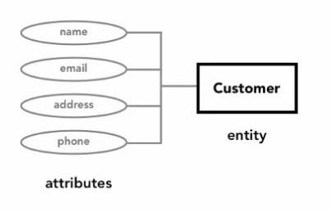
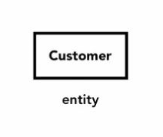
After figuring out our first list of what entities need to exist, we need take a look at each one to specify exactly what data is important to store about them. Now officially, in an entity-relationship model (ER), these are referred to as our attributes.
And just as entities will become our tables, the attributes we draw it here for each one will become the columns in those tables. Now in sketching out an ER diagram, attributes are often shown like this, and you can be quite informal about writing them. But as you move into actually defining the official columns of the table, you're going to need to become very specific about what they are

Slide 109

Entities and Attributes
First, as a rule when defining a table, let's say an Employee table, you're going to go very granular, meaning, as individual as possible, so not just one column for name, but separate columns for FirstName and LastName.
It is much easier to sort all your employees by surname or find out how many customers you have in a particular city, if you're storing that piece of data independently, rather than if it has to be extracted out of some larger value.

Slide 110
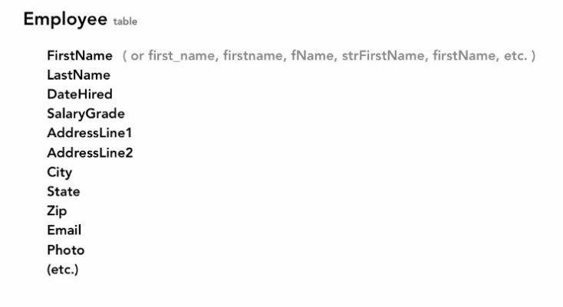
Entities and Attributes
What should we name these columns? There are a variety of ways that people name the columns in their tables, sometimes using underscores between multiple words, sometimes a lower case using Camel case, Pascal case, this has really more to do with your own naming conventions, than anything a database will enforce on you. As ever, the best idea is simply to have a standard and stick to it.
I'll be using Pascal casing in my examples, meaning, I'll upper case each word, and I won't use underscores. Now, some databases do support using spaces in your column names, but I avoid those as they often mean a name has to be enclosed in quotes when referring to it programmatically, and this becomes inconvenient. But this is by no means enough.

Slide 111
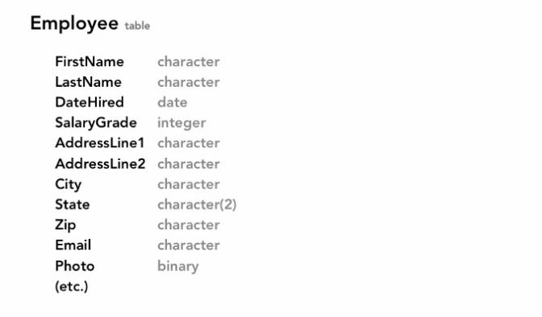
Entities and Attributes
You next have to say what kind of data is going to be stored in each of these columns, really what is the data type for each column? Is it text or character data, or is it numeric? Is it a date, a time, or even binary data like an image, or a piece of audio or video?
Data types in a database are absolutely not the same as data types in a programming language. You'll find that most database systems want you to be much more specific about your columns than a programming language wants you to be about your variables, and the Database Management System wants to know these specifics so it can be efficient about storing and indexing them, and so it can enforce your rules.

Slide 112
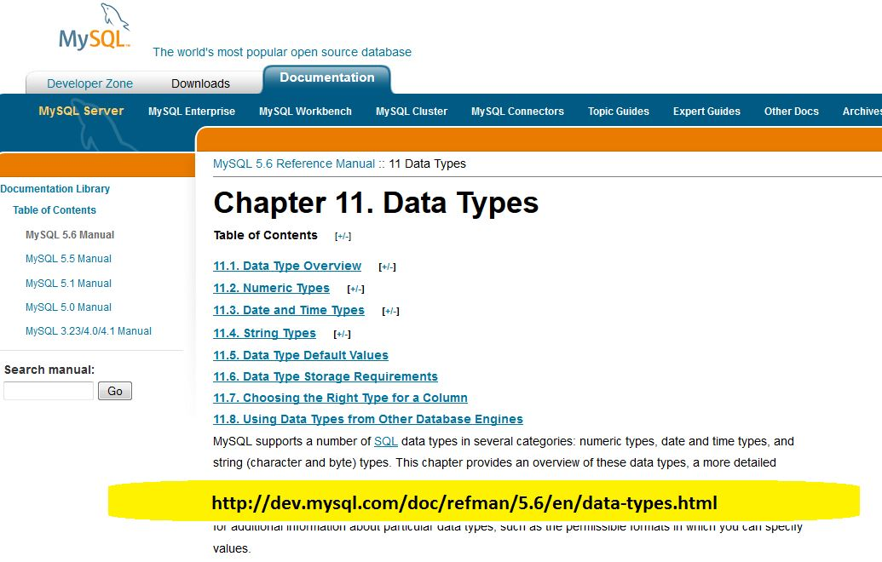
Entities and Attributes
For example, if you want to store an integer in one of your columns, you'll find that most Database Management Systems have multiple kinds of integer data type for different sizes of integer. If I look at the online manual for the MySQL Database Management System, I can go into the Numeric Types, and I'll find that just for integer alone… →
http://dev.mysql.com/doc/refman/5.6/en/data-types.html

Slide 113
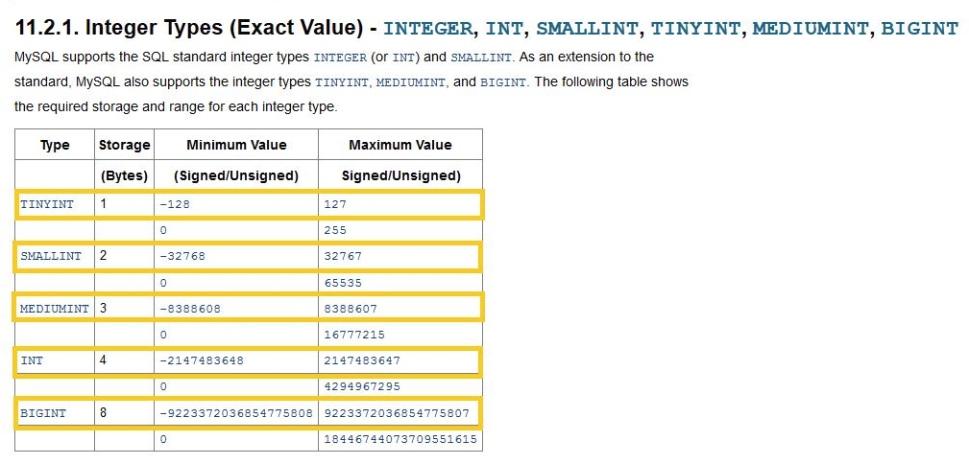
Entities and Attributes
→ …we got the regular INT, we've also got TINYINT, SMALLINT, MEDIUMINT and a BIGINT, all different lengths in terms of storage from one to eight bytes, and all different sets of numbers that they can take, whether they're signed (negative number) to unsigned (positive only number) values.

Slide 114
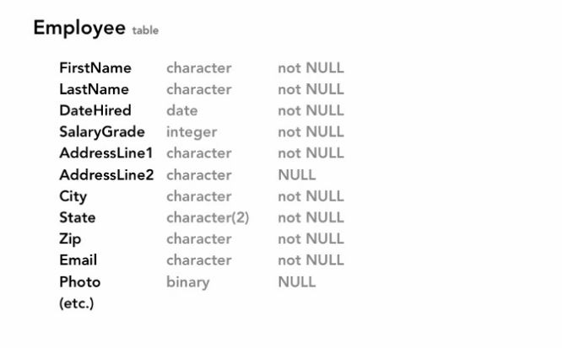
Entities and Attributes
After defining the data type and optionally the length, one very important question is when you add a new row, will a value be required in this column or is it optional? Most databases default to requiring all columns to contain values, but sometimes that's not necessary. You might require, for example, a value in AddressLine 1, but not in AddressLine 2, it's just not needed, it's not relevant. So, what you do is you actually define particular columns to allow null values.
Null is an important keyword in relational databases. A null is not the same as just a space or a blank entry. Null means the complete absence of a value. So, your columns can be defined as allowing null values, or more typically a column can be not null. A value is required.
Notes:
Now, with some data types, things like character or text data, you can also specify if it should be a fixed length or a variable length. I might specify it here, for example, that my state should be limited to just two characters. And really, this all comes down to you knowing what each piece of data should be. And if you've got some character data is it going to represent a FirstName or might it represent the content of a 1,000-page manuscript? The idea here is that you want to use a column definition that's as small as possible but no smaller. Fixed lengths are more efficient. But as you might imagine, they're just not all about flexible. If you try and store a 15-character name in a column only defined as 12-characters, you'll just lose the last three characters.
You will also find that many database systems have different options for storing ASCII text and Unicode text. So, if you know you're storing international text, big five languages and so on, you'll need to pick a Unicode character format. And even though Unicode does take up more space, I tend to default the Unicode format unless I absolutely know I won't need them. And then there's the option of storing binary data, a photo, a video, audio, a document where you typically have a binary type. Now some databases have specific methods for dealing with very large binary objects, gigabytes of binary files. You may hear these data types referred to as Binary Large Objects or BLOBs. Now likewise, large amount of text can be managed differently as Character Large Objects or CLOBs.

Slide 115
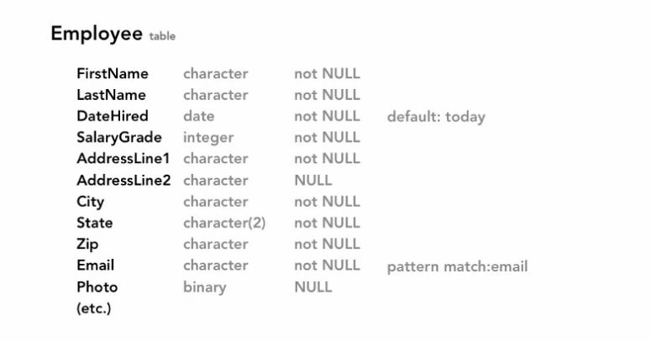
Entities and Attributes
And one option here is that perhaps a default value for a column. So if you don't provide a value, can a default value be entered automatically? I might say, for example, that when I'm creating a new employee row, if I don't put anything in for the date hired, it will default to today's date, the date the row was created. Along the same lines, we might do some constraints to check are there maximum or minimum values for something. Should it match a pattern, like matching an email address or a phone number or a credit card number? Flexibility is usually our friend in programming, but it's not what you're looking for in most relational database.
Notes:
If you want to store an email address for an employee, you want to know what will always be an email address, not sometimes an email address, sometimes an inspiring quote or a date or an MP3 file or just missing entirely. What you're hoping to end up with is that for each table, each entity that you have, you have a reasonable list of the columns to create and the data allowed in each column. And defining your columns as exactly as possible, means that your database will enforce these rules on those columns, that your data will stay valid and consistent, and you won't end up with a database full of garbage.

Slide 116
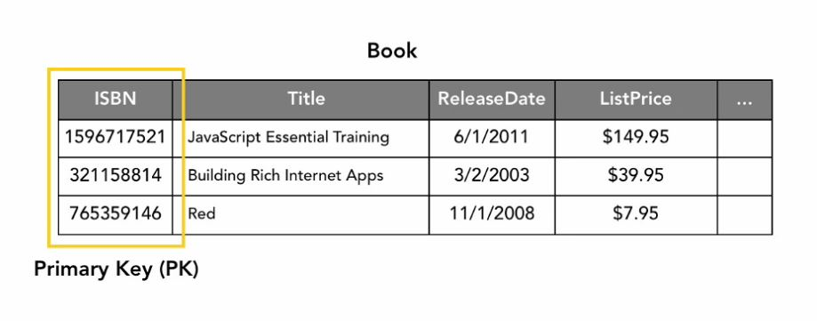
Choosing Primary Keys
Each table should have a Primary Key, a value that uniquely identifies an individual row where there can be no duplicates and no confusion. So, if we have an EmployeeID, it should take us to only one employee row. If we have a CustomerID, it takes us to only one customer row. If we have an ISBN number, it takes us to one specific book. When creating a database schema, we need to say which column contains that Primary Key for each of our tables, and if there isn't one, we usually need to make one. Occasionally the key is already naturally in the data.
If, for example, I define a Book table where we enter all the details of a book, including its ISBN, well, that ISBN number should be naturally unique. I could then tell the database that this is the Primary Key, and because it occurs in the data, this is what sometimes called a Natural Key. However, in many examples, it doesn't naturally occur.

Slide 117
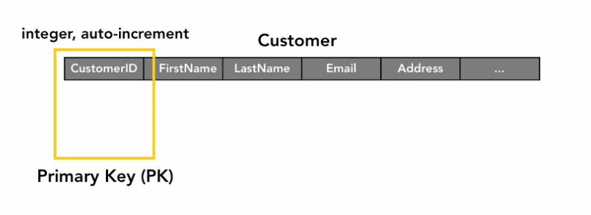
Choosing Primary Keys
As I start to build our Customer table, I might realize there's nothing in this that's inherently unique.
We might say that Email is unique, but sometimes the same Email address is shared by multiple people as this the same address.
If I decide there's nothing that I could guarantee would always be unique, I would add a Customer ID column.

Slide 118
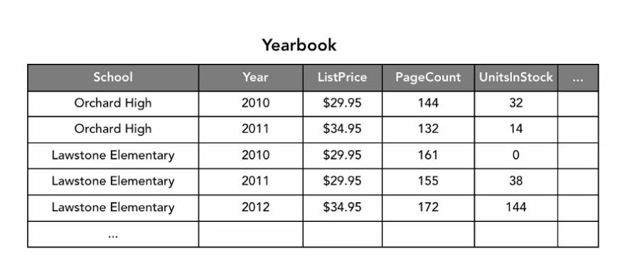
Using Composite Keys
One option for a Primary Key that you might find useful from time to time is something called a Composite Key. This is when one value does not uniquely identify a row, but two values do, where we'd combine two column values to create a unique Primary Key. It sounds a little weird, so let me give you an example.
Let's imagine I've got a publishing company and part of what I do is deal with Yearbooks for high schools. So, I have a Yearbook table. Now, the way this currently stands, none of these columns are naturally a potential Primary Key. There's nothing here that's inherently unique. The School name repeats and the Year repeats. PageCount might be unique but that's just coincidence. We're not looking for something that may be unique, if we're lucky. We need something that will always be and must be unique and makes logical sense to use when identifying each row. So, I can't use the School name. I can't use the Year, but what we can do is combine them.

Slide 119
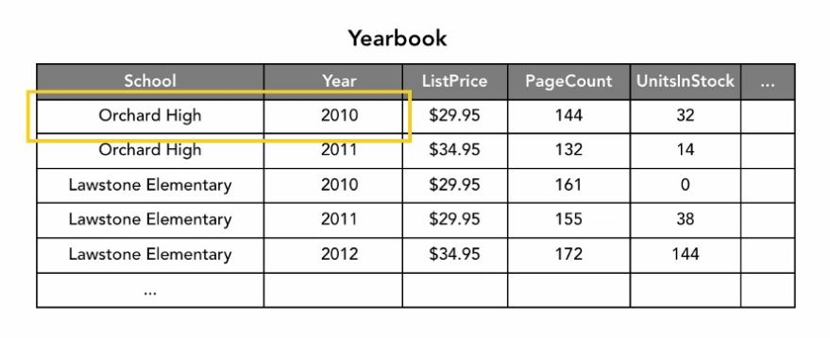
Using Composite Keys
If in this Yearbook business, we create one book for each School per year, then if I select the name and the year that can uniquely identify each row. There might be multiple rows for Orchard High and multiple Years for 2010, but there's only one Orchard High for 2010. Only one Orchard High for 2011, only one Lawstone Elementary for 2010, and so on. This is a legitimate Primary Key, and this is known as a Composite Key where it's composed of two or more values. Now, it's true it might sometimes be more useful or even just be more convenient to generate a surrogate Primary Key column anyway. Say in this case, a column called Yearbook ID that will automatically generate an integer, but Composite Keys can be a useful technique, and you will run into them from time to time. One place you will see them, and we'll see them later on is they're used when we're joining tables together to create many-to-many relationships.

Slide 120
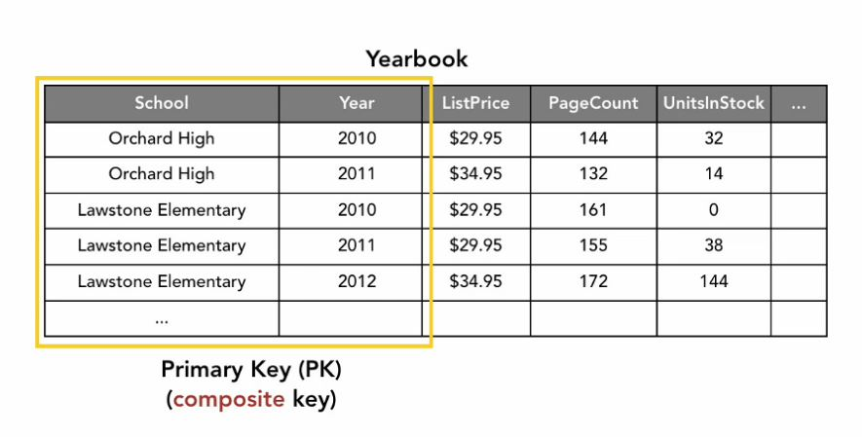
Using Composite Keys

